Slide 1
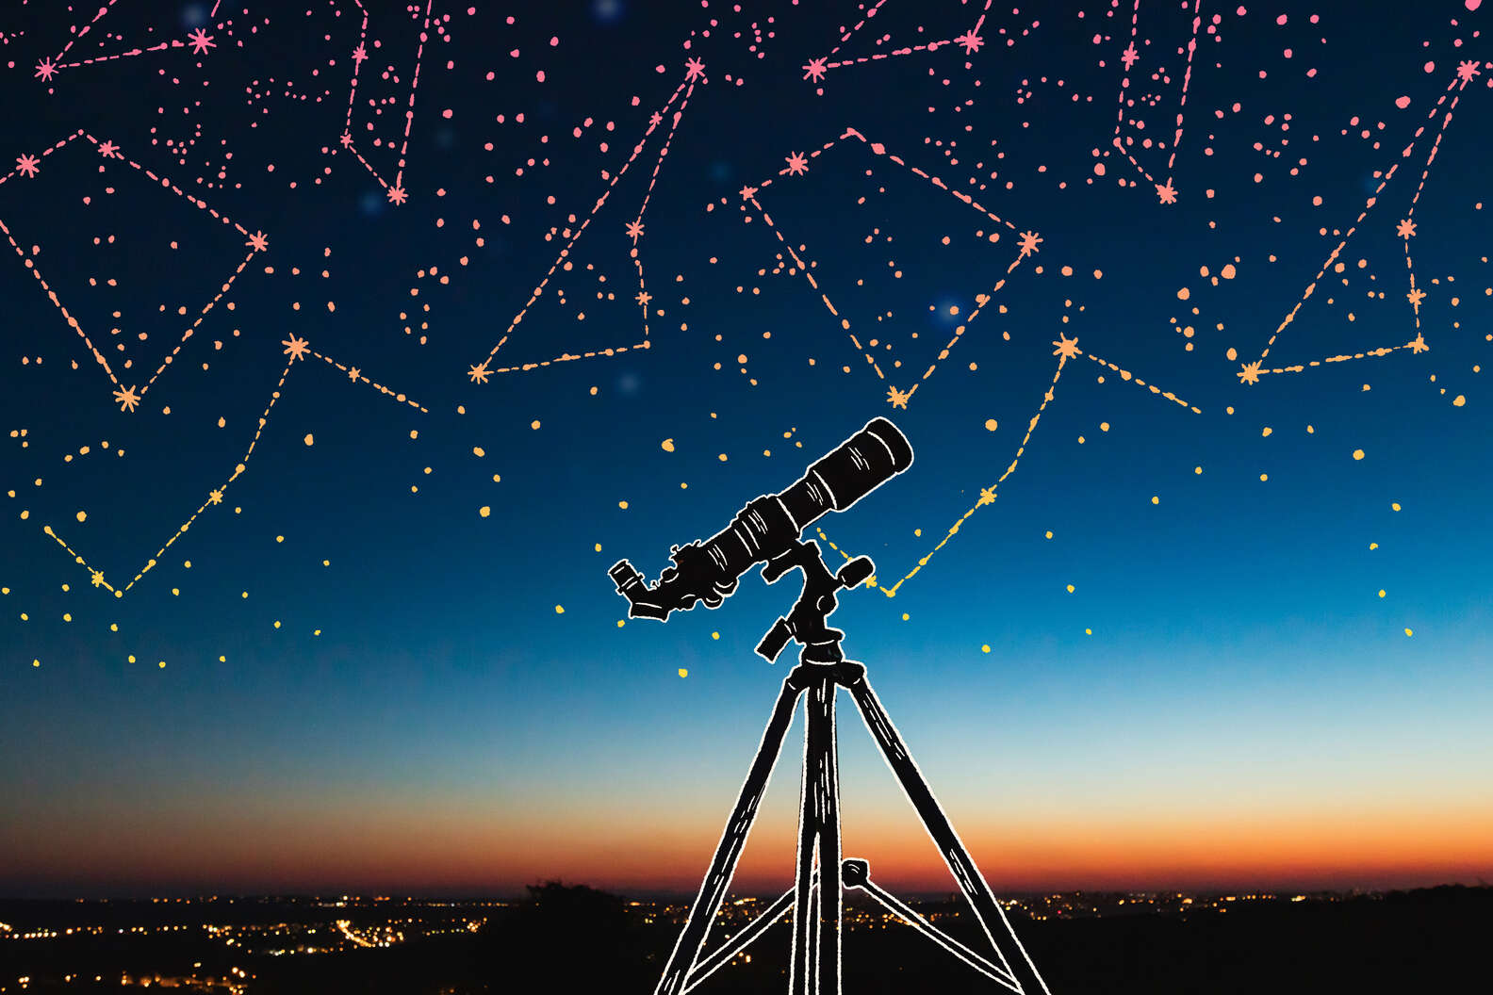
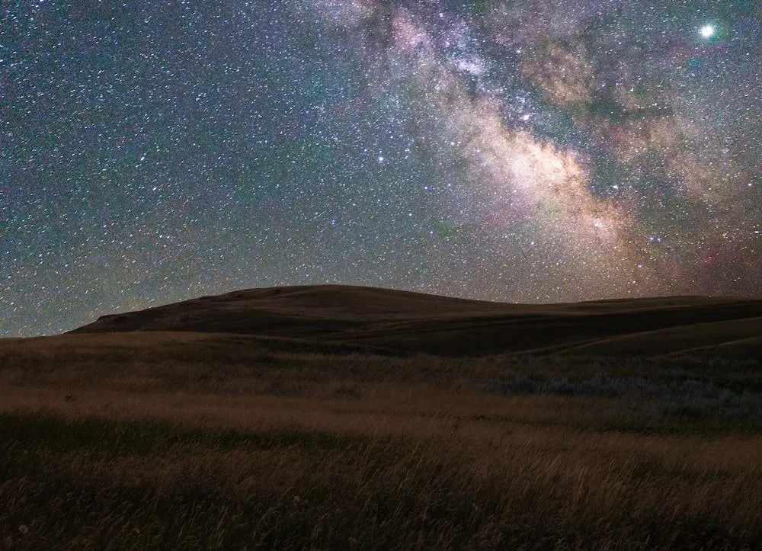
Starscope : a star gazing service
by Indus Valley World School

Slide 2
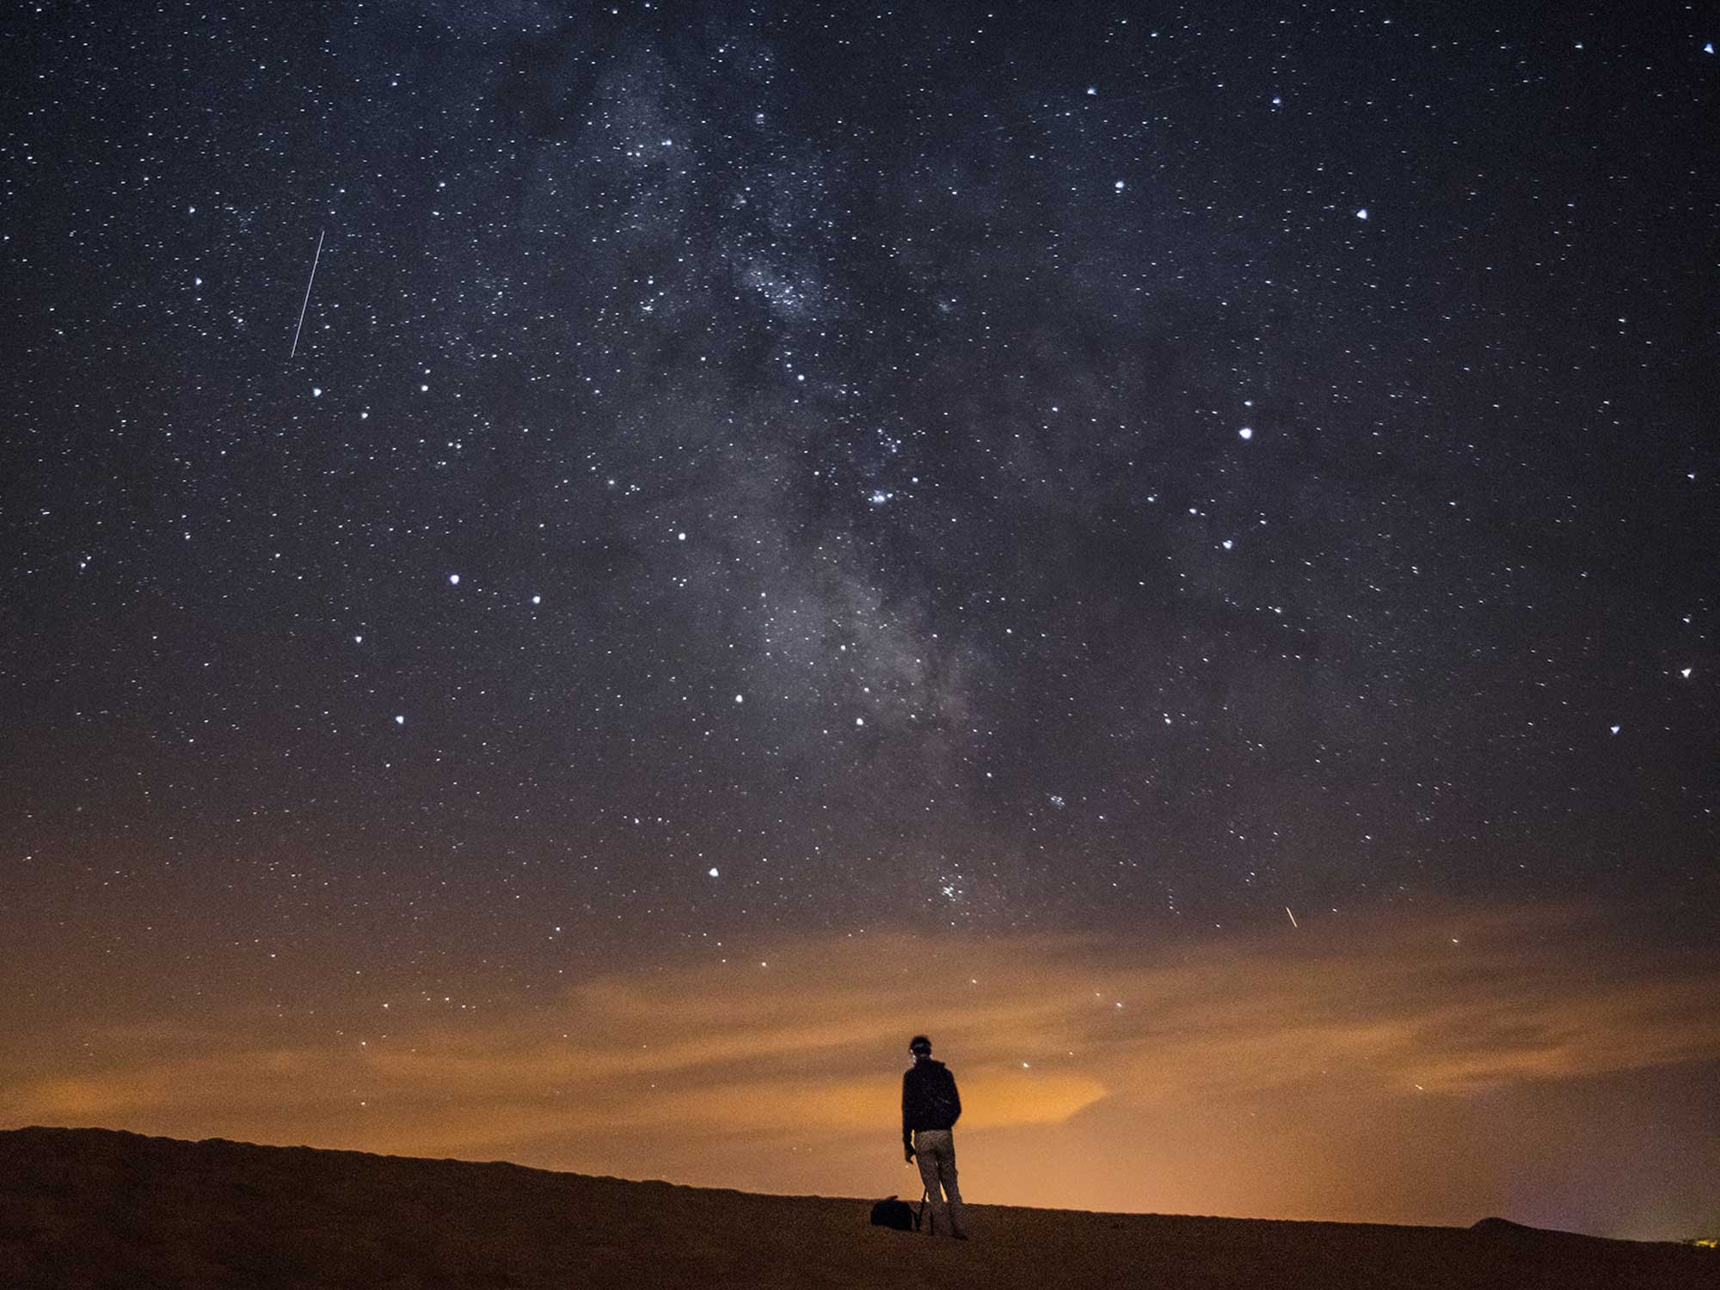
Problem statement
No strong online presence of to expand its reach and streamline service delivery.
Scattered information and no facilitate user engagement.
Starscope : a star gazing service

Slide 3
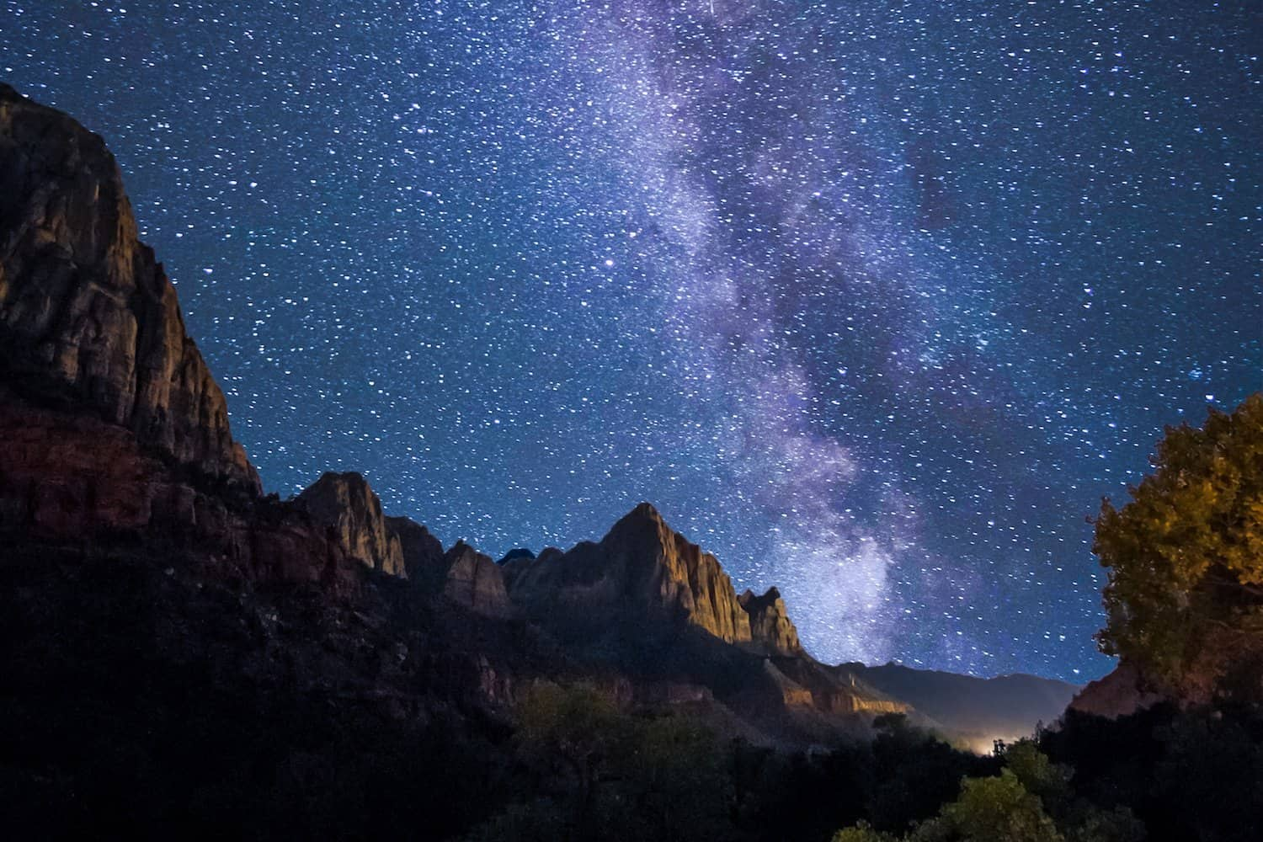
Key features of our website:
Real time constellation finder.
Guided telescope tours.
Celestial event livestream.
Educational webinars.
Event countdown trakers .
Problem statement
No strong online presence of to expand its reach and streamline service delivery.
Scattered information and no facilitate user engagement.
Starscope : a star gazing service

Slide 4
Tech stack
Front end:
React + Vite + TypeScript
React query
Tailwind CSS + Shadcn/UI + Framer Motion
Back end :
Node.js + Express + TypeScript

Slide 5
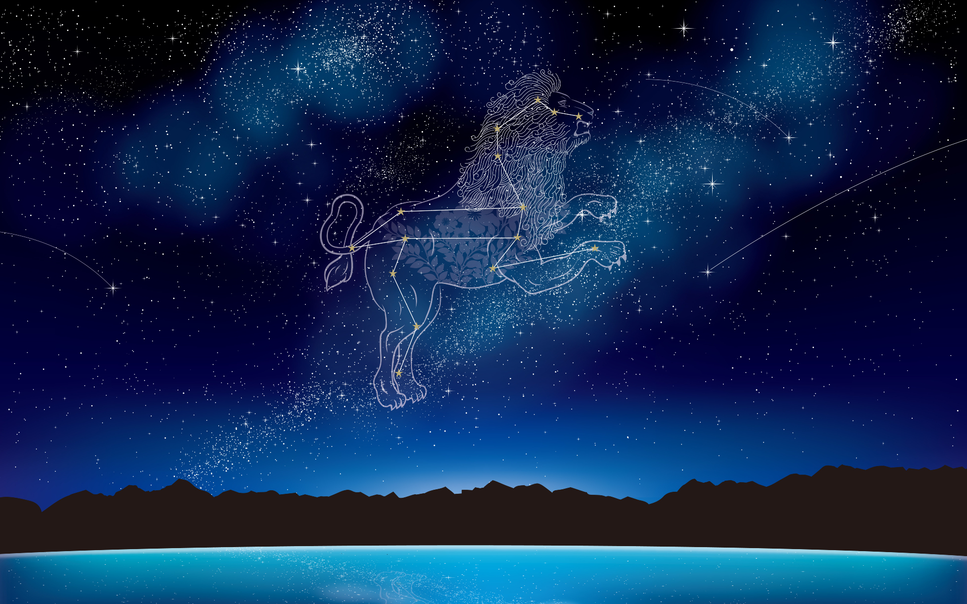
UI AND UX DESIGN
Space-themed palette — deep blues, purples, gradients, and starlight whites.
Clean, modern sans-serif fonts for easy readability.
Tailwind CSS ensures the app looks great on mobile, tablet, and desktop
Visual elements : Constellation map, animated backgrounds, orbiting action buttons

Slide 6
Why people should choose starscope?
All in one astronomy platform.
Made for everyone: beginner friendly and powerful enough for advanced users.
Interactive , not boring.

Slide 7
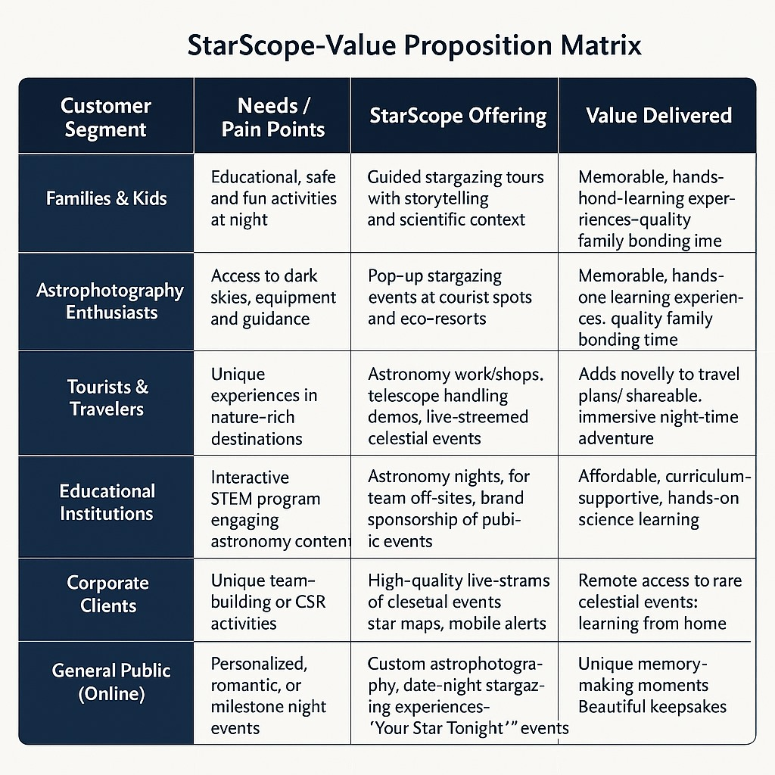
StarScope Value Proposition Matrix: Serving Every Stargazer

Slide 8
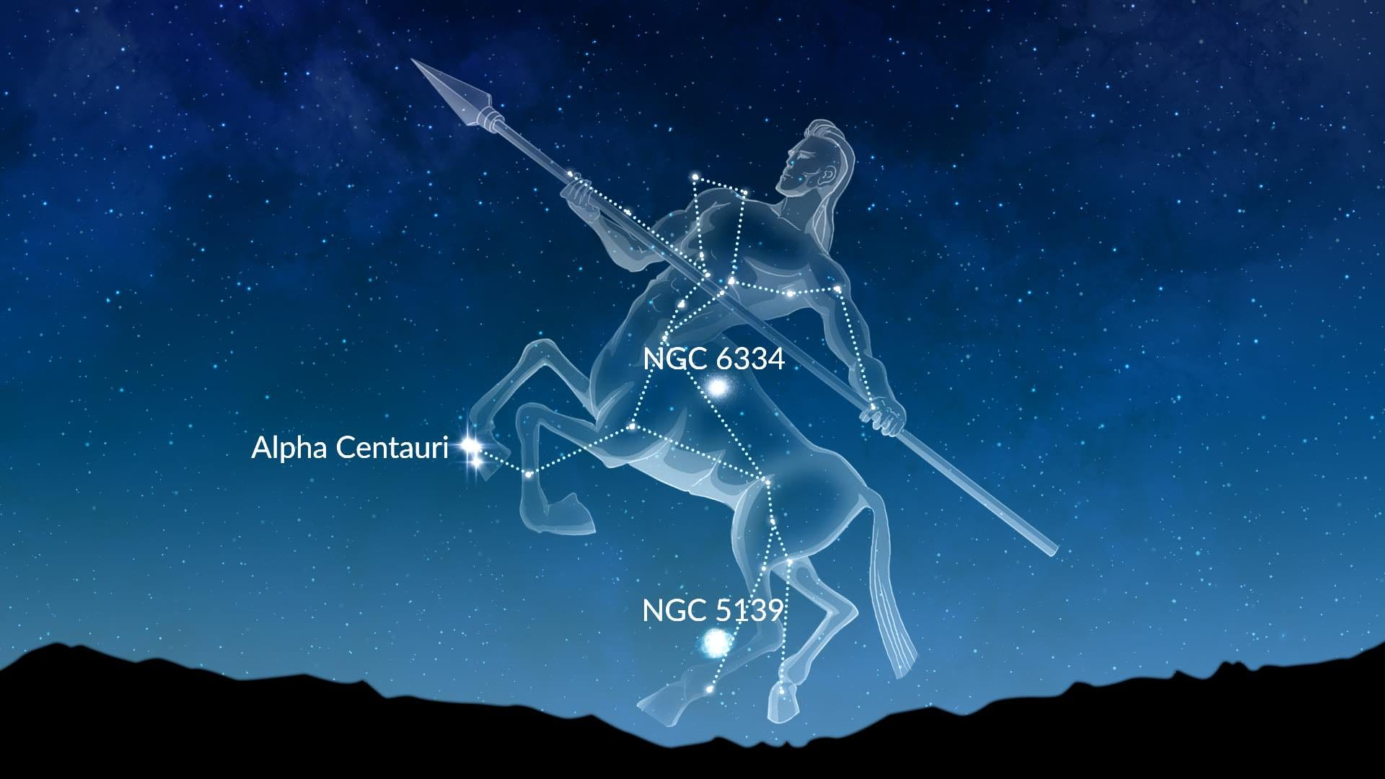
Future scopes that can be implemented:
Personalized Stargazing Calendar
Educational Hub & Quizzes
Global stargazing community

Slide 9
Conclusion
StarScope is more than just a website — it's a complete stargazing experience built for everyone who’s ever looked up at the night sky and wondered what’s out there.
With modern design, real-time features, and interactive tools, StarScope connects people to the cosmos through guided tours, astrophotography, live events, and educational content — all in one place.

